Slide 1
Module -1 (Overview of algorithms)
Prepared by
Dr.S.Jenicka
Associate professor grade 1
SCOPE-Analytics
VIT Vellore

Slide 2
Problem solving
Identify and define the problem.
Generate possible solutions.
Evaluate alternatives.
Decide on a solution.
Implement the solution.
Evaluate the outcome.

Slide 3

What are problem solving tools?
Flow chart
2. Algorithm
3. Pseudocode
4. Program

Slide 4
Algorithm
An algorithm is a sequence of unambiguous
instructions for solving a problem, i.e., for obtaining a required output for any legitimate input in a finite amount of time.
An algorithm is a sequence of computational steps ( a well defined computational procedure) that transform the input to output.

Slide 5
Algorithm -contd
Sorting algorithm
Input: A sequence of numbers (56,47,23,89,90)
Output: A sorted list (23,47,56,89,90)
Instance of a problem: It consists of the input sequence to the sorting problem

Slide 6
Types of algorithms
1. Non recursive or iterative
2. recursive

Slide 7
Euclid’s algorithm for finding GCD of 2 numbers (non recursive or iterative)
Non recursive:
FindGCD(int m,int n)
{
int r;
while(n!=0)
{
r=m%n;
m=n;
n=r;
}
return m;
}
Tracing
iteration | m | n | r
 | 8 | 4
1 | 4 | 0 | 0
Output:
4

Slide 8
Recursive algorithm
A recursive algorithm is an algorithm that calls itself.

Slide 9
Euclid’s algorithm for finding GCD of 2 numbers (recursive)
Tracing
Recursive:
FindGCD(int m, int n)
{
int r;
r=m%n;
if (r==0) return n;
else return FindGCD(n,r)
}
Call | m | n | r
FindGCD(21,12) | 21 | 12 | 9
FindGCD(12,9) | 12 | 9 | 3
FindGCD(9,3) | 9 | 3 | 0
Output:
3

Slide 10
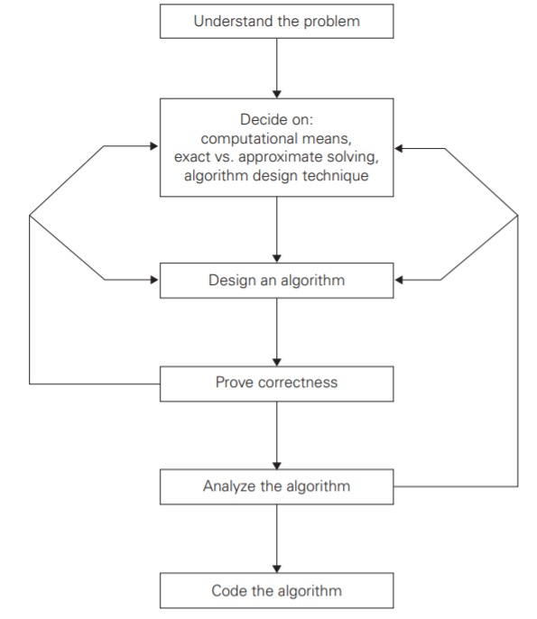
Stages of algorithm development for solving a problem:

Slide 11
Understanding the problem:
Read the problem’s description carefully and ask questions if you have any doubts about the problem. An input to an algorithm specifies an instance of the problem the algorithm solves.

Slide 12

Ascertaining the capabilities of computational device
1. We must know about the machine -its speed and memory
2. We must know whether we develop sequential or parallel algorithms
3. For some algorithms involving huge data, execution time and storage requirement are critical

Slide 13
Choosing between exact and approximate problem solving
We must choose between solving the problem exactly called as exact algorithm or solving it approximately called as approximation algorithm.
Why would one need approximation algorithm?
For example extracting square roots, solving nonlinear equations, and evaluating definite integrals cannot be solved. Second, available algorithms for solving a problem exactly can be unacceptably slow because of the problem’s intrinsic complexity.

Slide 14
Identifying a suitable technique:
An algorithm design technique (or “strategy” or “paradigm”) is a general approach to solving problems algorithmically that is applicable to a variety of problems from different areas of computing.

Slide 15
Algorithm design techniques
Brute force
Divide and conquer
Decrease and conquer
Dynamic programming
Greedy approach
Backtracking algorithm
Branch and bound algorithm

Slide 16
Brute force
Brute force is a straightforward approach to solving a problem, usually directly based on the problem statement and definitions of the concepts involved.

Slide 17
Divide and conquer
Divide-and-conquer algorithms work according to the following general plan:
A problem is divided into several subproblems of the same type, ideally of about equal size.
The subproblems are solved (typically recursively, though sometimes a different algorithm is employed, especially when subproblems become small enough).
If necessary, the solutions to the subproblems are combined to get a solution to the original problem.

Slide 18
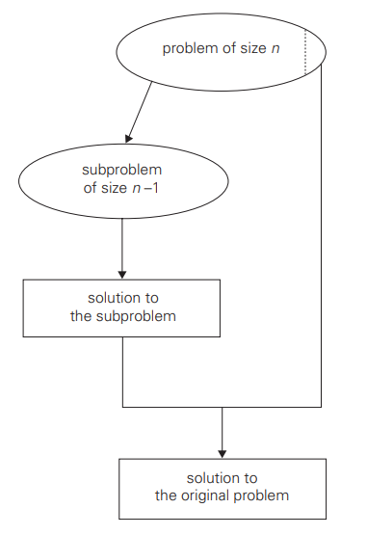
Decrease and conquer
The decrease-and-conquer technique is based on exploiting the relationship between a solution to a given instance of a problem and a solution to its smaller instance. (eg. Non recursive Binary search algorithm)

Slide 19
Dynamic programming
Dynamic programming is a technique for solving problems with overlapping subproblems.
Typically, these subproblems arise from a recurrence relating a given problem’s solution to solutions of its smaller subproblems.
Rather than solving overlapping subproblems again and again, dynamic programming suggests solving each of the smaller subproblems only once and recording the results in a table from which a solution to the original problem can then be obtained.

Slide 20
Greedy
The greedy approach suggests constructing a solution through a sequence of steps, each expanding a partially constructed solution obtained so far, until a complete solution to the problem is reached.
On each step the choice made must be: feasible, i.e., it has to satisfy the problem’s constraints locally optimal, i.e., it has to be the best local choice among all feasible choices available on that step and irrevocable, i.e., once made, it cannot be changed on subsequent steps of the algorithm

Slide 21
Backtracking
Backtracking is a more intelligent variation of this approach. The principal idea is to construct solutions one component at a time and evaluate such partially constructed candidates as follows.
If a partially constructed solution can be developed further without violating the problem’s constraints, it is done by taking the first remaining legitimate option for the next component.
If there is no legitimate option for the next component, no alternatives for any remaining component need to be considered. In this case, the algorithm backtracks to replace the last component of the partially constructed solution with its next option.

Slide 22
Branch and bound
The central idea of backtracking, can be strengthened with an optimization problem.
An optimization problem seeks to minimize or maximize some objective function (a tour length, the value of items selected, the cost of an assignment, and the like), usually subject to some constraints.
In optimization problems, a feasible solution is a point in the problem’s search space that satisfies all the problem’s constraints (e.g., a Hamiltonian circuit in the traveling salesman problem or a subset of items whose total weight does not exceed the knapsack’s capacity in the knapsack problem), whereas an optimal solution is a feasible solution with the best value of the objective function (e.g., the shortest Hamiltonian circuit or the most valuable subset of items that fit the knapsack).

Slide 23
Branch and bound -Contd
Compared to backtracking, branch-and-bound requires two additional items:
a way to provide, for every node of a state-space tree,
a bound on the best value of the objective function on any solution that can be obtained by adding further components to the partially constructed solution represented by the node the value of the best solution seen so far.

Slide 24
Design of an algorithm:
Some design techniques can be simply inapplicable to the problem in question.
Sometimes, several techniques need to be combined
Even when a particular design technique is applicable, getting an algorithm often requires a nontrivial ingenuity on the part of the algorithm designer.

Slide 25
Proof of Correctness of the algorithm:
Once an algorithm has been specified, you have to prove its correctness. That is, you have to prove that the algorithm yields a required result for every legitimate input in a finite amount of time.

Slide 26
Example for checking correctness of an algorithm
Checking correctness
a[]= {45,23,67,2}, n=4
Output : 67 (The algorithm works correctly for the given set of input)
Finding maximum from a list of elements
iteration | i | max | a[i]
0 |  | 0
1 | 1 | 45 | 45
2 | 2 | 45 | 23
3 | 3 | 67 | 67
4 | 4 | 67 | 2
int findMaximum(int a[],int n)
{
max=0;
for(i=1;i<=n;i++)
if (a[i]>max)
max=a[i];
return max
}
a[]= { -17, -10, -4}, n=3
Output: 0 (The algorithm works incorrectly for the given set of input)
iteration | i | max | a[i]
0 |  | 0
1 | 1 | 0 | -17
2 | 2 | 0 | -10
3 | 3 | 0 | -4

Slide 27
Example for checking correctness of an algorithm- contd
Checking correctness
So we initialize max as follows
a[]= { -17, -10, -4}, n=3
iteration | i | max | a[i]
0 |  | -17
1 | 1 | -10 | -10
2 | 2 | -4 | -4
int findMaximum(int a[],int n)
{
max=a[1];
for(i=2;i<=n;i++)
if (a[i]>max)
max=a[i];
return max
}
Output
-4
This algorithm works correctly for the given set of input

Slide 28
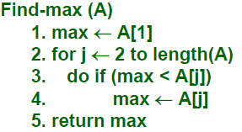
Algm Correctness Proof –By Contradiction
Prove that for any valid Input, the output of Find-max satisfies the output condition.
Proof by contradiction:
Suppose the algorithm is incorrect.
Then for some input A,
Case 1: max is not an element of A. max is initialized to and assigned to elements of A – which is impossible.
Case 2: (∃ j | max < A[j]).
After the jth iteration of the for-loop (lines 2 – 4), max ≥ A[j]. From lines 3,4, max only increases.
Therefore, upon termination, max ≥ A[j], which contradicts our assumption that max<A[j]

Slide 29
Loop invariance –Correctness proof
Show the 3 things about a loop invariance:
Initialization: It is true prior to the first iteration of the loop.
Maintenance: If it is true before an iteration of the loop, it remains true before the next iteration.
Termination: When the loop terminates, the invariant gives us a useful property that helps us to show that the algo is correct.

Slide 30
Loop invariance proof –Max algm
Prove that for any valid Input, the output of Find-max satisfies the output condition.
Proof by loop invariants:
Loop invariant: I(j): At the beginning of iteration j of the loop, max contains the maximum of A[1,..,j-1].
Proof:
True for j=2.
Assume that the loop invariant holds for the j iteration,
So at the beginning of iteration k, max = maximum of A[1,..,j-1].

Slide 31
Loop invariant proof for max
For the (j+1)th iteration
Case 1: A[j] is the maximum of A[1,…,j]. In lines 3, 4, max is set to A[j].
Case 2: A[j] is not the maximum of A[1,…,j]. So the maximum of A[1,…, j] is in A[1,…,j-1]. By our assumption max already has this value and by lines 3-4 max is unchanged in this iteration.

Slide 32
Loop invariant proofs
STRATEGY: We proved that the invariant holds at the beginning of iteration j for each j used by Find-max.
Upon termination, j = length(A)+1. (WHY?)
The invariant holds, and so max contains the maximum of A[1..n]

Slide 33
Analyzing an algorithm
Analyzing an algorithm implies predicting the resources the algorithm requires.

Slide 34
Analysis of algorithms
Analysis of Algorithms
Analysis of Recursive algorithms
Substitution
method
Recursive tree method
Using Master theorem
Analysis of Non recursive algorithms

Slide 35
Algorithm time efficiency or time complexity
Running time of an algorithm on a particular input is the number of primitive operations or steps executed. It is done in two steps.
Identify the basic operation
Find how many times it is executed
T(n)=C_{op} C(n) where ‘n’ is the input size
C_{op} is the execution time taken by basic operation
C(n) is the number of times it is executed.

Slide 36
Steps involved in algorithm analysis of non-recursive algorithms
Decide on a parameter (or parameters) indicating an input’s size.
Identify the algorithm’s basic operation. (As a rule, it is located in the innermost loop.)
Check whether the number of times the basic operation is executed depends only on the size of an input. If it also depends on some additional property, the worst-case, average-case, and, if necessary, best-case efficiencies have to be investigated separately.
Set up a sum expressing the number of times the algorithm’s basic operation is executed.
Using standard formulas and rules of sum manipulation, either find a closed form formula for the count or, at the very least, establish its order of growth.

Slide 37
Analysis of non recursive algorithms – Finding Runtime complexity (T(n))
for (i=0;i<n;i++)
sum=sum+i;
i=0; is executed once
i<n; is executed (n+1) times
i++ ; is executed n times
Sum=sum+i; is executed n times
T(n)= 1+(n+1)+n+n=3n+2
for (i=0;i<n;i++)
for(j=0;j<n;j++)
sum=sum+i;
i=0; is executed once
i<n; is executed (n+1) times
i++ ; is executed n times
j=0; is executed n*1 times
j<n; is executed n*(n+1) times
j++ ; is executed n*n times
Sum=sum+i; is executed n*n times
T(n)=1+(n+1)+n+n+n(n+1)+n²+n²
T(n)=3 n²+4n+2

Slide 38
Element uniqueness problem –Non recursive algorithm
Algorithm findUnique(int a[0---n-1])
Input: an array of n elements in a[0--n-1]
Output: The program returns true if all array elements are distinct, otherwise it returns false
for(i=0;i<=n-2;i++)
{
for(j=i+1;j<=n-1;j++)
{
if (a[i]==a[j])
return false;
}
}
return true;
}

